Slide 1

RETURN OF THE MAC
HOW TO BRING IT BACK FROM A MALWARE ATTACK
Aspen Lindblom

Slide 2


Why start with installers
Anatomy of macOS installers
Demo
Hunting for indicators
Recommended tools

Slide 3
Before we begin: WARNING!!!
Be courteous
Live malware
Handle with care
Only execute samples in a VM
Isolate you VM, make sure it can’t access files on your host machine
Put your VM in Host-only mode

Slide 4
Before we begin: Malware Sample
Step 1: Make a copy of my github repository
$ cd ~/
$ git clone https://github.com/blcklstdbb/bsidessd.git
$ cd bsidessd
OR
Drag and drop bsidessd folder to home folder ~/
$ cp -r Desktop/bsidessd/ ~/bsidessd
$ cd bsidessd
The rest of the commands will be on the cheat sheet

Slide 5
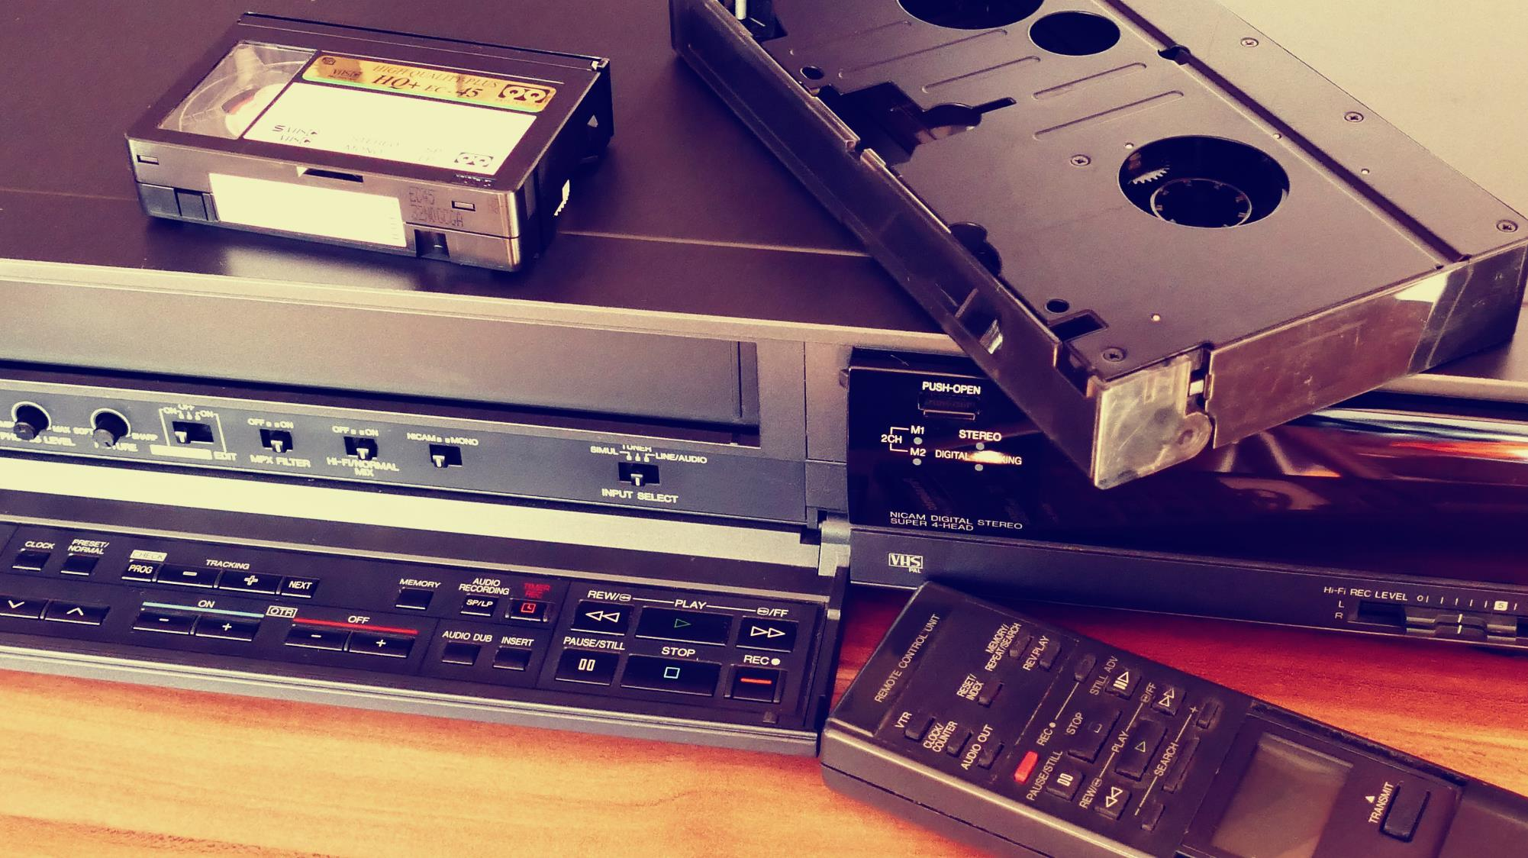





Malware Analysis: Why start with installers
Safety
Popularity
Overwhelming
Enlightenment
Level-up
macOS isn’t free of malware. The most common type of malware on mac is Adware.
While Windows dominates the market, malware is becoming more prevalent on macOS.
Getting started with macOS can feel overwhelming. It’s hard to know where to begin.
Analyzing installers will get you familiar with the basics of macOS.
Level-up your macOS skills to tackling mach-o files.

Slide 6
Anatomy of macOS installers: DMG Files
.dmg is a Disk Image file
Essentially a complete file system in a single file
Can have different file system formats:
Hierarchical File System Plus (HFS+)
Apple File System (APFS), replaces HFS+. Seen on High Sierra (10.13) and higher
Needs to be mounted
Can contain .pkg or .app files

Slide 7
Anatomy of macOS installers: DMG Files
Step 2:
$ hdiutil attach samples/JMTTrader.dmg
$ cp /Volumes/JMTTrader/JMTTrader.pkg malware/
$ hdiutil detach /Volumes/JMTTrader
$ hdiutil info

Slide 8
Anatomy of macOS installers: Pkg Files
.pkg are xar (eXtensible ARchive) archive files
Can contain the following files
Bom
PackageInfo
Payload
Scripts
The contents of the file can be extracted

Slide 9
Anatomy of macOS installers: Pkg Files
Step 3:
$ xar -xf malware/JMTTrader.pkg -C malware/
$ ls –la malware/

Slide 10
Anatomy of macOS installers: Bom
Bill of Materials
It is used by the installer to to determine which files to install, remove, or upgrade
Contains all the files within a directory, along with some information about each file
Viewable with lsbom

Slide 11
Anatomy of macOS installers: Bom
Step 4:
$ lsbom malware/bom
Questions:
Can you identify the folders where the files will be installed after reviewing the Bom file?
Does anything stand out to you as suspicious?

Slide 12
Anatomy of macOS installers: Scripts
Contains Preinstall and or Postinstall scripts
Usually archived with cpio
Can extract file contents with cpio

Slide 13
Anatomy of macOS installers: Payload
Encoded payload data in .pkg files
The actual package contents
Contains .app file
Can extract file contents with cpio

Slide 14
Anatomy of macOS installers: Payload & Scripts
Step 5:
$ cd malware/
$ cpio –i < Scripts
$ cpio –i < Payload
Questions:
Do you see a preinstall and or postinstall script?
What was in the Payload file?

Slide 15
Anatomy of macOS installers: App
Known as a bundled executable
A structured directory that you can browse the contents of and is made up of files and folders
Contains several plist files, mach-o files, libraries, scripts, etc
Since it is a directory you can view the contents inside it

Slide 16
Anatomy of macOS installers: App
Step 6:
$ ls -la Applications/JMTTrader.app/Contents/
$ ls -la Applications/JMTTrader.app/Contents/MacOS
$ ls -la Applications/JMTTrader.app/Contents/Resources
Questions:
What can you determine from the contents of the directory?
Hidden files start with a period (.) in front. Do you see any hidden files?

Slide 17

DEMO
Return of the mac(k)

Slide 18
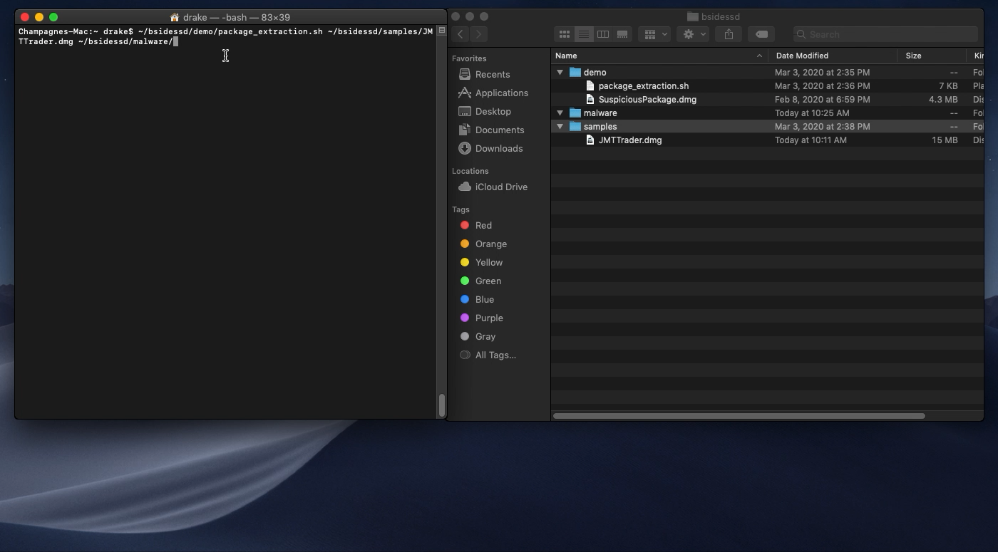

Slide 19
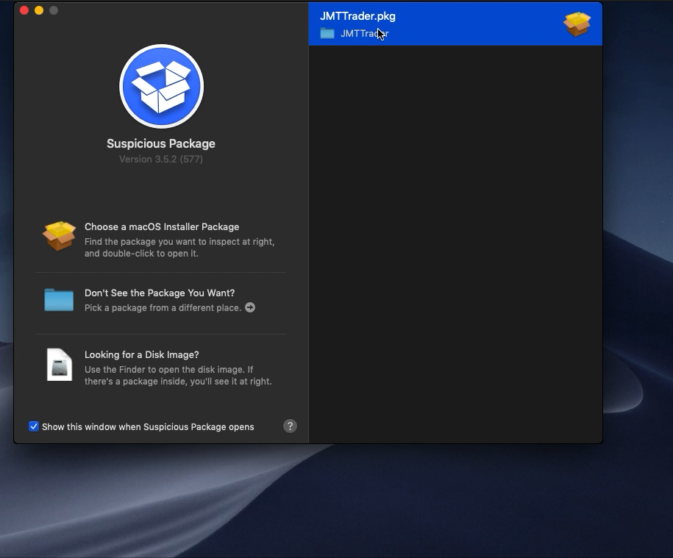

Slide 20
Hunting for indicators: Downloaded files from browsers
Files downloaded through web browsers have a quarantine tag
~/Library/Preferences/com.apple.LaunchServices.QuarantineEventsV*
This is an SQL database that holds information about files downloaded via a web browser.

Slide 21
Hunting for indicators: Downloaded files from browsers
Step 8:
$ sqlite3 ~/Library/Preferences/com.apple.LaunchServices.QuarantineEventsV* "select * from LSQuarantineEvent"
Questions:
Can you determine what files were downloaded?
What browser was used to download the files?

Slide 22
Hunting for indicators: ASEPs (Auto Start Extensibility Points)
ASEPs allows for an automatic execution of a process and offers persistence
Plists (Property Lists) are the main form of ASEPs
Plist are xml files
ASEP plists do not execute, they point to commands or programs and settings for launchd
Launchd is responsible for reading ASEP plists and carrying out the execution of their settings
Can be found all over the host but there are only a handful of locations that are searched and loaded when the hosts starts up

Slide 23
Hunting for indicators: Launch Daemons vs Launch Agents
Launch Daemons
Launch Agents
Loaded at system startup
Background processes
Malware will prefer to use Launch Daemons
Located at:
/Library/LaunchDaemons
System-wide daemons installed by the admin
/System/Library/LaunchDaemons
System-wide daemons provided by Apple
Loaded at user login
May interface with the user
Allows for a GUI to be associated with it
Located at:
/Library/LaunchAgents
Per-user agents installed by the admin
/System/Library/LaunchAgents
Per-user agents provided by Apple
~/Library/LaunchAgents
User’s individual agents

Slide 24
Hunting for indicators: Launch Agents vs Launch Daemons
The <array> block underneath <key>ProgamArguments</key> will contain the command or program for launchd to run.
When the RunAtLoad key is set to true launchd will run the program or command at startup:
<key>RunAtLoad</key>
<true/>
When the StartInterval is set launchd will check every 300 seconds to see if the program is running and start it if it is not running:
<key>StartInterval</key>
<integer>300</integer>
When SuccessfulExit is set to true launchd will restart the program if it ends successfully:
<key>SuccessfulExit</key>
<true/>

Slide 25
Hunting for indicators: Launch Agents vs Launch Daemons
Step 9:
$ cat samples/postinstall
$ cat Applications/JMTTrader.app/Contents/Resources/.org.jmttrading.plist
Questions:
Will this plist file be a Launch Agent or Launch Daemon?
What are the command arguments?
How often will the command arguments run?

Slide 26
Hunting for indicators: Get those hashes
Step 10:
$ shasum -a 256 Applications/JMTTrader.app/Contents/Resources/.CrashReporter
Questions:
Has the hash of this executable file been seen on VirusTotal?
Can you find information regarding the file on objective-see.com?
Notes:
Identifying the malware family will help to identify other indicators and files to remove during remediation.

Slide 27
Hunting for indicators: Recap
Trojanized cryptocurrency trading application developed by Lazarus APT group
Targets various cryptocurrency exchanges
postinstall script moves hidden plist file, org.jmttrading.plist, to Launch Daemon folder
postinstall script creates /Library/JMTTrader then moves hidden mach-o file, CrashReporter, to that folder
CrashReporter is a downloader

Slide 28
Recommended tools
Free tools available from:
Natively & 3rd party
Newosxbook.com
Objective-See.com
gdb
lldb
codesign
Activity Monitor
otool
IDA
Ghidra
hexfiend
jtool2
FileMon
Process Explorer
ProcessMonitor (Requires Catalina)
FileMonitor (Requires Catalina)
What’s Your Sign?
KnockKnock
Dylib Hijack Scanner

Slide 29
Links
https://objective-see.com
https://mothersruin.com/software/SuspiciousPackage
https://developer.apple.com/library/archive/navigation/
http://www.newosxbook.com/index.php
Books
*OS Internals Volume I & II by Jonathan Levin
OS X Incident Response by Jaron Bradley

Slide 30
THANK YOU
Aspen Lindblom
https://github.com/blcklstdbb
https://twitter.com/aspen_assassin
https://www.linkedin.com/in/aspenw

